Slide 1
Optical communications and data networks (EENGM2001)
Siddarth K Joshi

Slide 2
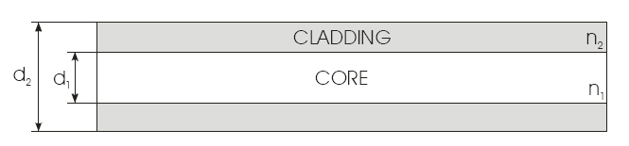
Fibre optics: recap
Cladding usually made of pure SiO₂
Core usually made by doping SiO₂ with GeO₂ to make refractive index (slightly) higher (n₁>n₂)
Simplistic picture of wave-guiding:
Total internal reflection of light rays
this picture is suitable for multimode fibre
Note not all rays are allowed, only those at particular angles so that phase shift in one transverse round trip is m*2π
Allowed rays are called ‘(transverse) modes’

Slide 3
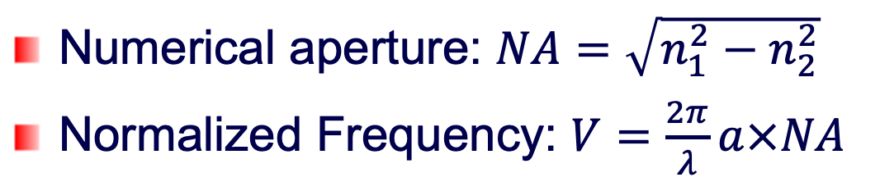
Fibre optics
For a step-index fibre, the mode volume is given by V²/2. For single-mode operation, it is required that V < 2.4048, the first root of the Bessel function J₀.
2a
n₁
n₂
For multi mode fibre the approx. number of guided modes = V

Slide 4
Fibre optics
Low V number => more bend loss and cladding loss
High V number => more scattering loss
2a
n₁
n₂

Slide 5
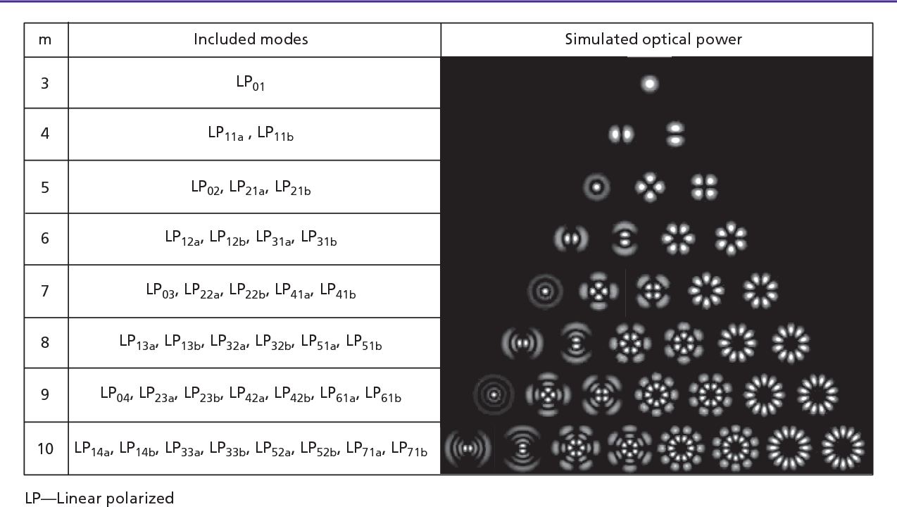
Fibre optics
Degenerate mode groups in GRIN fibre
Degenerate: all have same energy.

Slide 6
Modes: Clarification
Longitudinal Modes of lasers and Transverse Modes of fibres
‘Modes’ are patterns of electromagnetic fields resulting from having to satisfy boundary conditions and self-consistent phase conditions (for constructive interference)
Don’t confuse (transverse) modes of fibre with (longitudinal) modes of laser
Transverse modes refer to light field patterns in the cross-section of fibre
Longitudinal modes refer to the light field patterns in the propagation direction in laser cavities – they result in distinct frequencies / wavelengths to be emitted.
A single (longitudinal) mode laser can also cause many (transverse) modes in fibre if these modes are allowed in the particular type of fibre.
Badly designed lasers can also have multiple transverse modes. This causes energy being not concentrated in space, hence is usually to be avoided.

Slide 7
Phase Vs Group velocity
Group Velocity = Speed of the wave packet
Phase velocity = Propagation speed of the phase of any one frequency component
Group Velocity = Speed of information transfer
Also it refers to the motion of the envelope

Slide 8


Phase Vs Group velocity
Defined in terms of
Angular frequency
Wave Vector $k=\frac{2π}{λ}$

Slide 9
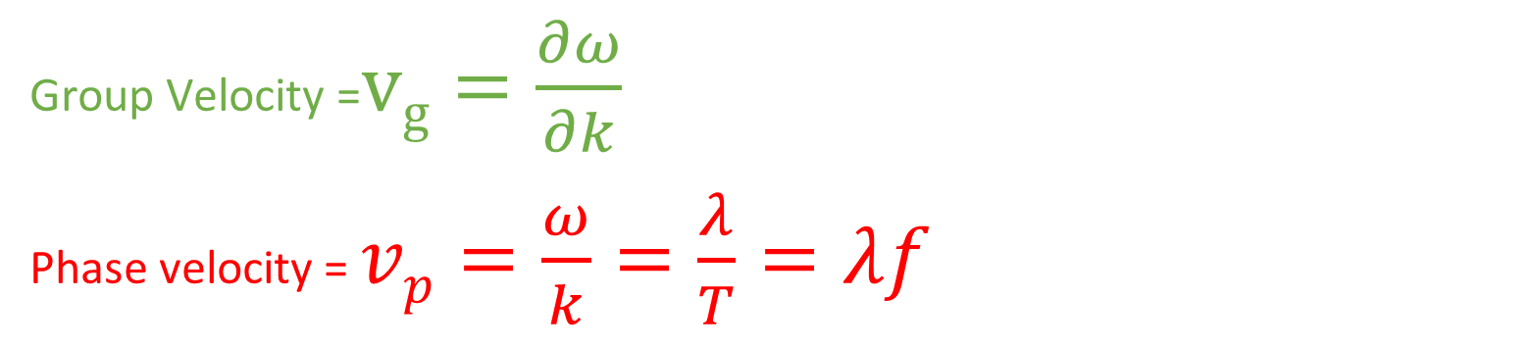
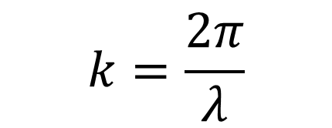

Phase Vs Group velocity
Group Velocity =$vg=\frac{∂ω}{∂k}$
Phase velocity = $vp=\frac{ω}{k}=\frac{λ}{T}=λf$
When $ω=ω(k)$
$$k=\frac{2π}{λ}$$
$ω=ω(k)$ is called the dispersion relation of the medium

Slide 10
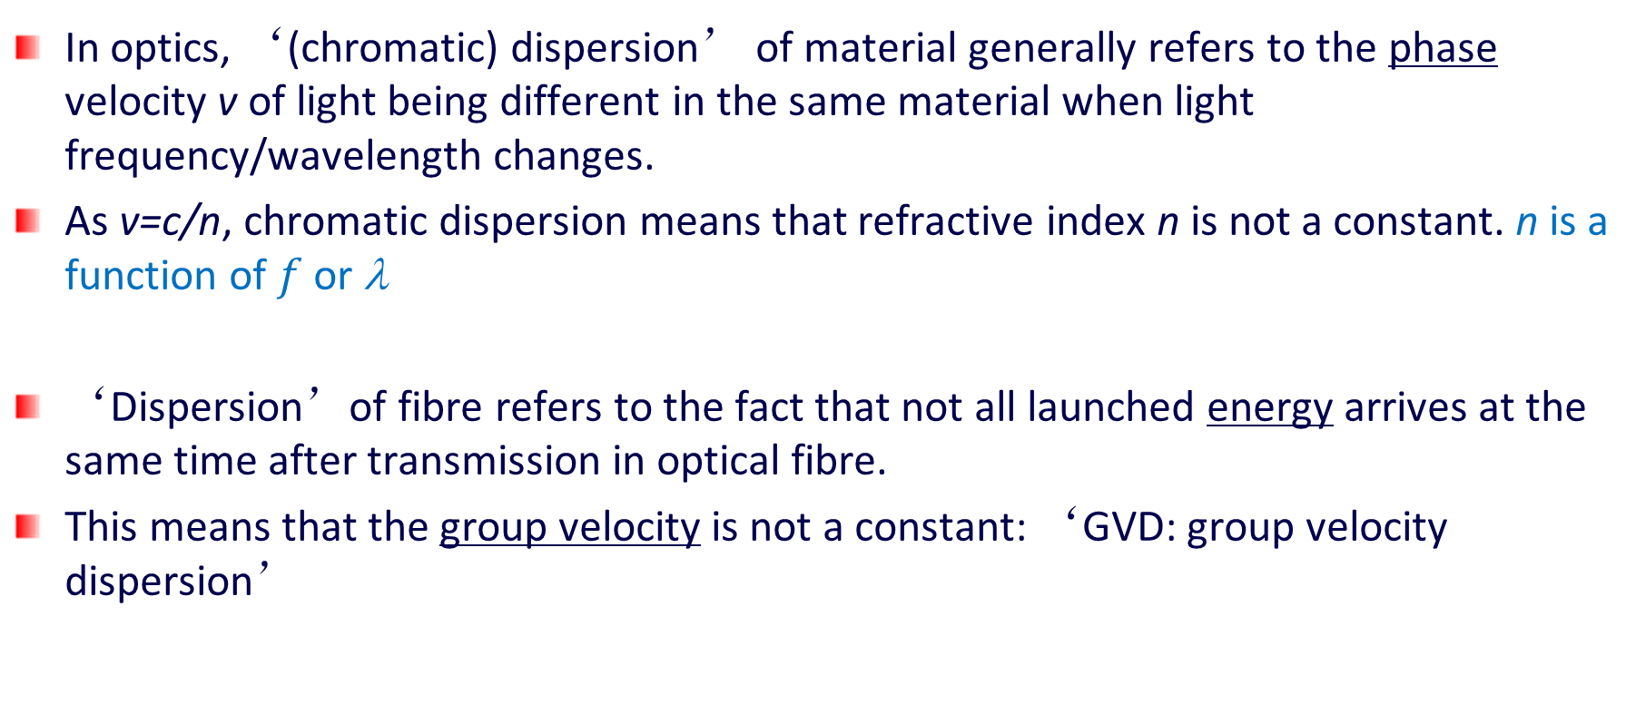
Dispersion: Origins
In optics, ‘(chromatic) dispersion’ of material generally refers to the phase velocity v of light being different in the same material when light frequency/wavelength changes.
As v=c/n, chromatic dispersion means that refractive index n is not a constant. n is a function of $f$ or λ
‘Dispersion’of fibre refers to the fact that not all launched energy arrives at the same time after transmission in optical fibre.
This means that the group velocity is not a constant: ‘GVD: group velocity dispersion’

Slide 11
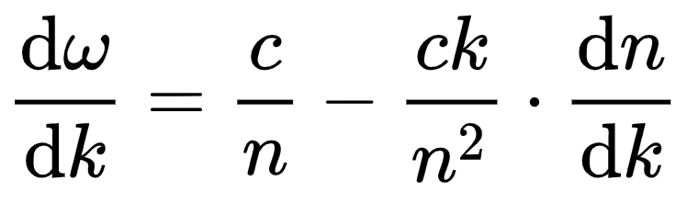
Phase Vs Group velocity
To convey information a sine wave must be modulated (i.e. changes is frequency, amplitude, phase, etc).
The ratio between the speed of light c and the phase velocity v_{p} is known as the refractive index, n = c/v_{p} = ck/ω
If the refractive index does not change with k then group and phase velocities are the same.

Slide 12
Dispersion
In multimode fibre
In single mode fibre

Slide 13
Dispersion: MM
Group dispersion:
MMF
large inter-mode dispersion dominates as different rays (modes) travel different lengths hence take different time to arrive.
Even if light has only 1 frequency, inter-mode dispersion still exists.
Dispersion is more severe at shorter wavelengths because there are more modes.

Slide 14
Dispersion: MM
GRIN fibre
GRIN fibre was designed to have ‘zero’ inter-modal dispersion because the ‘meridian’ rays should have same lengths.
But ‘spiral’ rays exist and they are still slower so GRIN fibre still has dispersion – smaller than step index fibre.

Slide 15
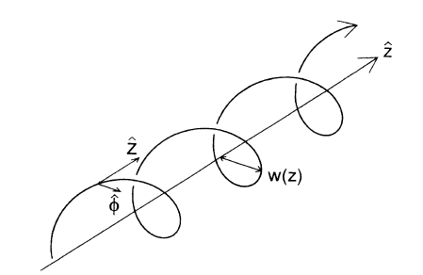
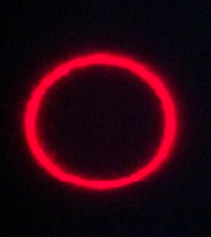
Spiral Rays
Do not confuse with circular polarisation
Spiral rays are a family of special transverse modes
They are characterized by a light pattern that travels around the axis at a certain radius
The intensity pattern is a ring (or doughnut) shape
Each ray is different by the pitch of the spiral
We are trying to make use of these rays for increasing transmission channels

Slide 16
Bandwidths
The signal BW of optical fibre means ’the limitation to the bandwidth of the envelope signal that modulates the lightwave’
‘optical bandwidth’ of a fibre or a device means ‘the width of a transparency window (e.g., of a fibre or a filter)’ in frequency or wavelength’
Energy in the optical bandwidth will pass through the fibre, but the modulation waveform may have disappeared due to limited signal BW!

Slide 17
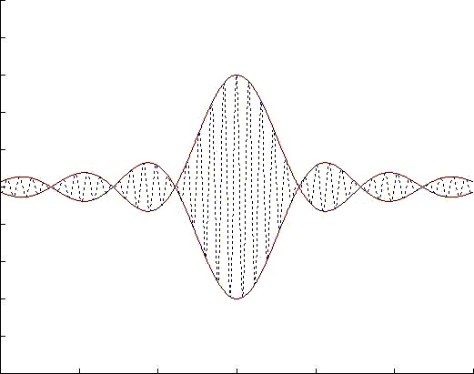
Dispersion: MM
Assume: all modes have the same power P_{m},
MMF bandwidth-length product
Input envelope function
output envelope
function
v_{g}^{(m)} is the group velocity of mode m.

Slide 18

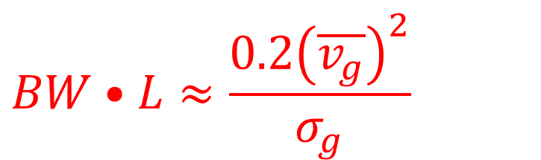
Dispersion: MM
The absolute delay τ (or mean value of v_{g}) doesn’t matter.
The differential delay is important:
$$Δτ=\frac{L}{{\left(\overline{v_{g}}\right)}^{2}}σ_{g}=\frac{\overline{τ}}{\overline{v_{g}}}σ_{g}$$
σ_{g} is the variance of v_{g}. Assuming all modes carrying equal power,
the bandwidth of fibre can be roughly estimated by
$$BW•L≈\frac{0.2{\left(\overline{v_{g}}\right)}^{2}}{σ_{g}}$$
or
Typical values of the BW-L product is in the order of 20 MHz-km for standard multimode fibres (50 or 62.5 micron core diameter)

Slide 19
Dispersion: MM
Bandwidth-length Product of Various Multimode Fibres
Fibre type | wavelength | Bandwidth (MHz × km)
 |  | LED source | Laser source
MMF step index, 200/230 mm, or 1 mm plastic | 665 nm
 | 850nm | 15 | 20
MMF GRIN 50/125mm or 62.5/125mm | 850nm | 70 | 200
 | 1310nm | 400 | 600
Dispersion imposes serious limitation to fibre bandwidth

Slide 20
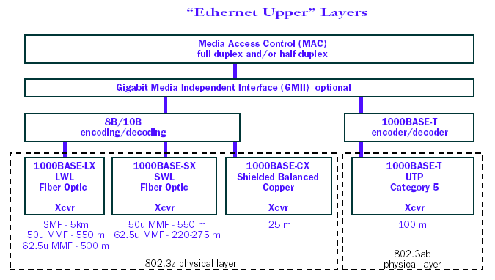
Length limits
AKA Giga bit ethernet or IEEE 802.3ab
1270–1355 nm
770 to 860nm
https://en.wikipedia.org/wiki/Gigabit_Ethernet

Slide 21
Dispersion: MM
BW Problems in GbE Transmission
In MMF mostly inter-modal dispersion.
We assumed that each mode has equal power.
Multi-mode fibre used for most of legacy networks
Bandwidth-length product in order of 20 MHz-km
Upgrading to Gb/s data rate over several hundred meters seems impossible
Fibre core
LED
Acceptance angle of fibre
Angular distribution of light

Slide 22
Dispersion: MM
Overcoming this problem
Not all mode that can exist have to exist…
Method 1: If only the lowest order mode is excited, then there is only one mode and there is no inter-modal dispersion
This is achievable by centre launch: illuminate only central part of the fibre core with a collimated beam
However this is not stable
Also fibres are not perfect – they have a index depression in the middle which wrecks things…
0th mode
Higher order modes

Slide 23
Dispersion: MM
Vg
Method 2: launch into higher order modes:
The difference between propagation constants of modes become smaller at higher mode numbers.
If lower order modes are not excited (does not carry optical power) the bandwidth would increase.
This can be achieved by illuminating the fibre off-center, called off-set launch.
Mode number
The modal dispersion curve

Slide 24
Dispersion: MM
Fibre core
Such techniques used only because of existing old deployed fibre
Changing fibre used is the most difficult in any real network
Laser diode off-set launch
Fibre core
SMF off-set launch using off-set patch cord

Slide 25
Dispersion
In multimode fibre
In single mode fibre

Slide 26
Dispersion: SM
Group Velocity Dispersion in Single mode Optical Fibres
SMF
There is no inter-modal dispersion
dispersion is due to material chromatic dispersion and waveguide chromatic dispersion
Material dispersion is fixed
Waveguide dispersion can be engineered to give desired overall dispersion
Any light pulse has a non-zero spectral width
Different spectral components travel through the fibre at different speeds, therefore arriving at different delay time.

Slide 27
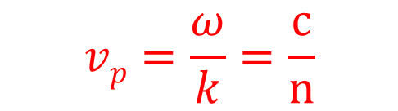

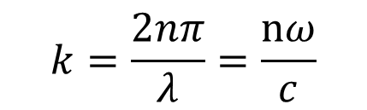
Dispersion: SM
$$vp=\frac{ω}{k}=\frac{c}{n}$$
Phase velocity of light in a material with refractive index n is
$$k=\frac{2nπ}{λ}=\frac{nω}{c}$$
Wave vector κ of the optical field in the material is
$$vg=\frac{∂ω}{∂k}$$
Group velocity is defined as
v_{g} can be calculated as
c=λω/2π
Physically, the group velocity is the speed at which the energy or the envelope of the waveform propagates.

Slide 28
Dispersion: SM
The delay of pulse propagation over length z is
The different values of v_{g} at different ω or λ causes the energy at different ω or λ to arrive at different time after propagating over a distance of z. This time difference can be calculated by
unit : ps.nm⁻¹km⁻¹
is defined as the fibre group velocity dispersion (GVD), which gives the amount of pulse spreading over 1 km if a signal pulse waveform has a spectral width of 1nm.

Slide 29
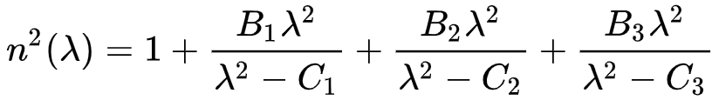
Dispersion: SM
n, v_{g}, and D
Sellmeier equation:
Vg is decided by the slope of n over λ or ω
n: non-linear, vg not const.,
D: NON-ZERO
You do not need to remember this equation. Just know that there is a quadratic dependence on wavelength.
n
Super-linear: D is positive
Sub-linear: D is negative
n: linear reduction,
v_{g}=const
D=0
ω
Normal dispersion medium
λ

Slide 30
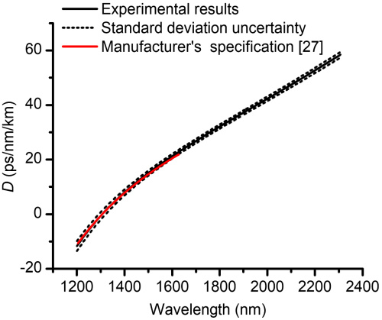
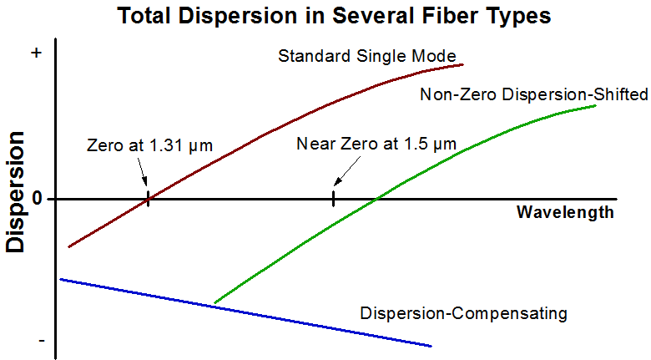
Dispersion: SM
t
Zero dispersion
Journal of the Optical Society of America B Vol. 35, Issue 6, pp. 1301-1307 (2018) https://doi.org/10.1364/JOSAB.35.001301

Slide 31
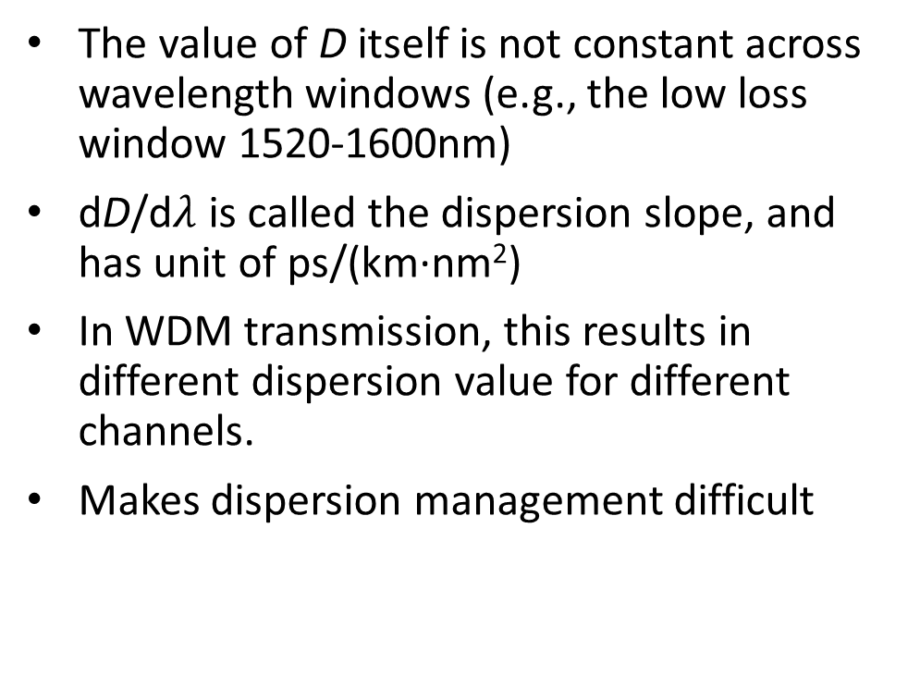
Dispersion: SM
Dispersion Slope
Signal spectrum
Signal spectrum
Signal spectrum
The value of D itself is not constant across wavelength windows (e.g., the low loss window 1520-1600nm)
dD/d$λ$ is called the dispersion slope, and has unit of ps/(km∙nm²)
In WDM transmission, this results in different dispersion value for different channels.
Makes dispersion management difficult
λ
1/v_{g}
D<0
D>0
D=0
λ
λ₁
λ₂
λ₃

Slide 32
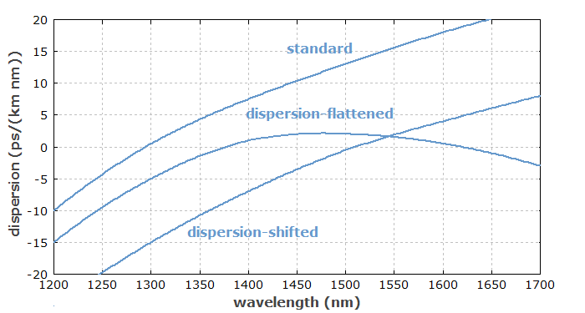
Dispersion: SM
Zero dispersion is not good either. It results in nonlinear effects within the fibre (e.g. four wave mixing)
Dispersion shifted/flattened fibres have higher dopant concentrations. i.e. Higher loss
Choice of fibre is a trade-off between dispersion, loss and cost

Slide 33
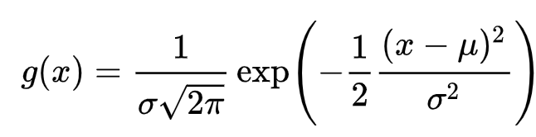
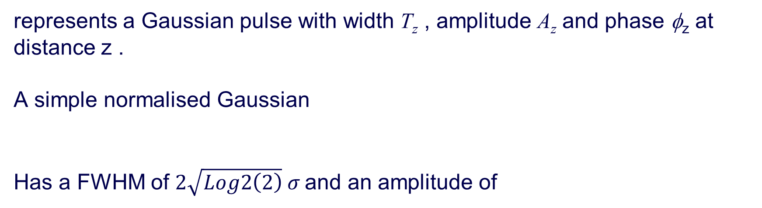
Dispersion
The Wave equation
represents a Gaussian pulse with width T_{z} , amplitude A_{z} and phase φ_{z} at distance z .
A simple normalised Gaussian
Has a FWHM of $2\sqrt{Log2\left(2\right)} σ$and an amplitude of

Slide 34
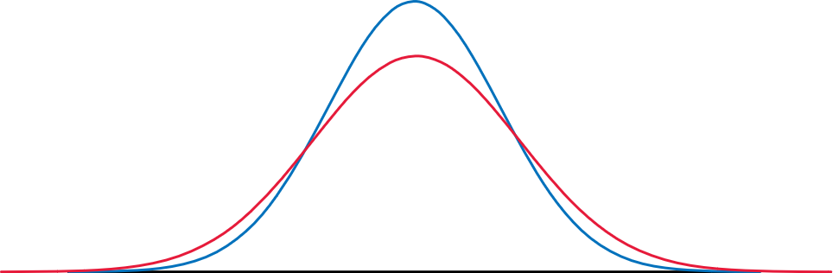
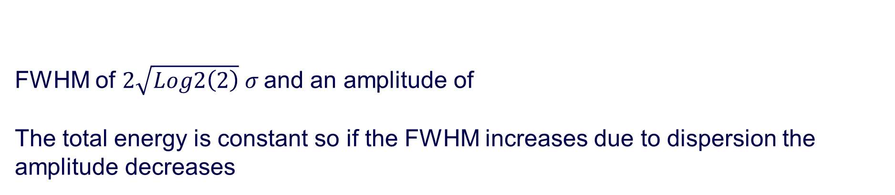
Dispersion
FWHM of $2\sqrt{Log2\left(2\right)} σ$and an amplitude of
The total energy is constant so if the FWHM increases due to dispersion the amplitude decreases

Slide 35
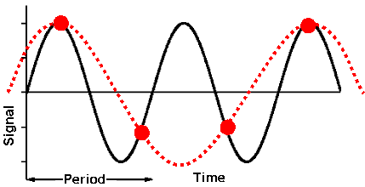
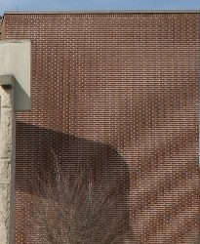
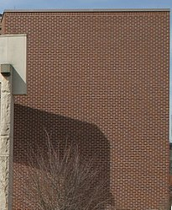
Nyquist Theorem
Under sampling a signal can lead to errors.
Nyquist Theorem states that the minimum sampling rate must be twice the signal frequency.
Pulses must be separated by at least twice the pulse width
Cannot distinguish
Can distinguish

Slide 36
Problem
Given a fibre of length 100km with a dispersion of 20ps/nm/km what is the maximum baud rate when using WDM channels of bandwidths 100GHz at 1550nm. If we use the entire spectrum from 190.1 THz to 195.0 THz such that the WDM spacing and bandwidth are 100GHz, what is the maximum cumulative Baud rate across all channels? (i.e. the total capacity of that fibre optic link). The dispersion slope is 2 ps/(km∙nm²).

Slide 37
Problem
100 GHz = 0.8 nm (@1550nm)
Dispersion after 100 km = 20*0.8*100 = 1.6 ns
For two pulses to be clearly distinguishable they need to be separated by at least twice the pulse width. Minimum pulse width = 1.6ns.
Thus max Baud (i.e. pulse) rate = 1/3.2ns = 312.5 MHz

Slide 38
Problem
At 1550 nm dispersion is 20ps/nm/km
The slope is given as 2ps/(km∙nm²)
Wavelength spacing is 100GHz i.e. 0.8nm Thus each adjacent channel has a change in dispersion of 2*0.8 = 1.6ps/km/channel
Lower wavelength has lower dispersion and higher wavelengths have more dispersion
1550nm is 193.4 THz (Ch34)
Baud[Hz] rate as a function of Frequency in THz is B(f) = 1/((2*(20+ (193.4-f)*1.6[ps/km/channel])[ps/nm/km]*0.8[nm]*100[km])*1e-12)
The total Baud rate is the sum over all possible frequencies.
I know that this may be difficult to do on some calculators, but is very easy to do in code. So this type of calculation will only happen if it is an open book online exam.

Slide 39
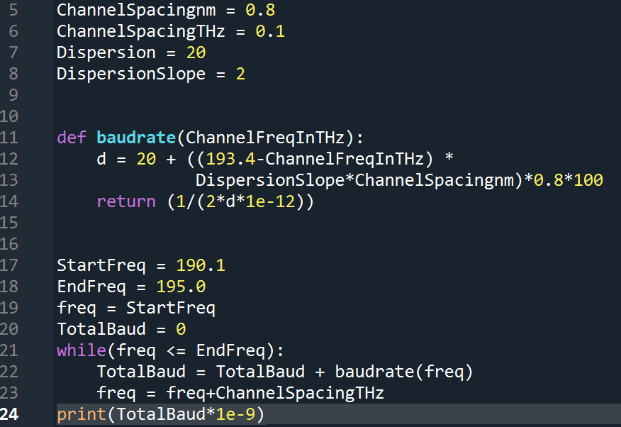
Problem
The total Baud rate is the sum over all possible frequencies.
Simple program to calculate it
Answer 14.8GHz is the max Baud rate.
This is less than 50 times the baud rate of the 1550nm channel (which would have been 15.6GHz)

Slide 40
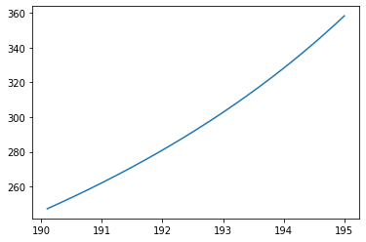
Problem
The baud rate can increase when the dispersion is lower
(193.4-f) Be careful of the sign here
Max Baud Rate [MHz]
Frequency [THz]

Slide 41
Problem
What would happen to the total baud rate if we were to use 50GHz channels, 25GHz channels, 12GHz and 6.5GHz . Will we double the baud rate in each case?

Slide 42
Problem
What would happen to the total baud rate if we were to use 50GHz channels, 25GHz channels, 12GHz and 6.25GHz . Will we double the baud rate in each case?
WDM Spacing [GHz] | Total Baud rate [GHz]
100 | 14.8
50 | 29.68
25 | 60.26
12.5 | 121.8
6.25 | 234.6

Slide 43
Problem
Using the 100 GHz channels if we could reduce the dispersion by 10% i.e. from 20ps/nm/km to 18ps/nm/km what would be the new total baud rate?
What would be the baud rate if the slope could be decreased by 10% instead?

Slide 44
Problem
Using the 100 GHz channels if we could reduce the dispersion by 10% i.e. from 20ps/nm/km to 18ps/nm/km what would be the new total baud rate?
What would be the baud rate if the slope could be decreased by 10% instead?
With a 10% reduction in dispersion we get a total baud of 16.38 GHz
But with a 10% reduction in the slope we get a total baud of 14.87 GHz

